Slide 1
A Funders Perspective
Maria Uhle
Co-Chair, Belmont Forum
Directorates for Geosciences, US National Science Foundation

Slide 2
Key components
Robust business model
Reduce risk
Leverage not duplicate
Innovative partnerships

Slide 3
Approach
Harnessing the strengths and abilities of others from different corners of your ecosystem is one of the most strategic ways to scale innovation and solve complex challenges
Notes:
Whether creating internal partnerships between colleagues or departments, to larger partnerships between businesses,

Slide 4
Work toward a common goal
Notes:
Identify the gap and opportunity
greatest success when opportunity drives collaboration
identify the specific challenge
Look at your customers and consider what their pain points are
best ideas come from combined solutions from different perspectives
Work toward a common goal
Establishing a common purpose sets the foundation and acts as the glue to holding the partnership together
Lean into each other's strengths
bring the best of their talent and strengths forward.
partnership strategy to play to those strengths
generates functional and creative solutions
consider geographical, gender etc. perspectives
Communication is key
clear communication between partners is essential
Leverage internal communication and collaboration channels
in-person meetings can go a long way
ensure there are no misaligned expectations between parties
Coordination is paramount -
Big breakthroughs and progress can't happen in silos
Working collaboratively with partners
within an organization as well as within your ecosystem to solve problems
generates the kind of energy that fuels growth, innovation and creativity

Slide 5
Identify the gap and opportunity
Identify the specific challenge
Stakeholder Challenges
Best ideas come from combined solutions from different perspectives
Greatest success when opportunity drives collaboration
Notes:
Identify the gap and opportunity
greatest success when opportunity drives collaboration
identify the specific challenge
Look at your customers and consider what their pain points are
best ideas come from combined solutions from different perspectives
Work toward a common goal
Establishing a common purpose sets the foundation and acts as the glue to holding the partnership together
Lean into each other's strengths
bring the best of their talent and strengths forward.
partnership strategy to play to those strengths
generates functional and creative solutions
consider geographical, gender etc. perspectives
Communication is key
clear communication between partners is essential
Leverage internal communication and collaboration channels
in-person meetings can go a long way
ensure there are no misaligned expectations between parties
Coordination is paramount -
Big breakthroughs and progress can't happen in silos
Working collaboratively with partners
within an organization as well as within your ecosystem to solve problems
generates the kind of energy that fuels growth, innovation and creativity

Slide 6
Lean into each other's strengths
Bring partner talent and strengths forward
Develop partnership strategy
Play to those strengths
Consider geographical, gender etc. perspectives
Generate functional and creative solutions
Notes:
Identify the gap and opportunity
greatest success when opportunity drives collaboration
identify the specific challenge
Look at your customers and consider what their pain points are
best ideas come from combined solutions from different perspectives
Work toward a common goal
Establishing a common purpose sets the foundation and acts as the glue to holding the partnership together
Lean into each other's strengths
bring the best of their talent and strengths forward.
partnership strategy to play to those strengths
generates functional and creative solutions
consider geographical, gender etc. perspectives
Communication is key
clear communication between partners is essential
Leverage internal communication and collaboration channels
in-person meetings can go a long way
ensure there are no misaligned expectations between parties
Coordination is paramount -
Big breakthroughs and progress can't happen in silos
Working collaboratively with partners
within an organization as well as within your ecosystem to solve problems
generates the kind of energy that fuels growth, innovation and creativity

Slide 7
Communication is key
Communication is key
Clear communication between partners is essential
Leverage communication and collaboration channels
in-person meetings can go a long way
Ensure there are no misaligned expectations between parties
Notes:
Identify the gap and opportunity
greatest success when opportunity drives collaboration
identify the specific challenge
Look at your customers and consider what their pain points are
best ideas come from combined solutions from different perspectives
Work toward a common goal
Establishing a common purpose sets the foundation and acts as the glue to holding the partnership together
Lean into each other's strengths
bring the best of their talent and strengths forward.
partnership strategy to play to those strengths
generates functional and creative solutions
consider geographical, gender etc. perspectives
Communication is key
clear communication between partners is essential
Leverage internal communication and collaboration channels
in-person meetings can go a long way
ensure there are no misaligned expectations between parties
Coordination is paramount -
Big breakthroughs and progress can't happen in silos
Working collaboratively with partners
within an organization as well as within your ecosystem to solve problems
generates the kind of energy that fuels growth, innovation and creativity

Slide 8
Communication is key
Coordination is paramount
Big breakthroughs and progress can't happen in silos
Working collaboratively to solve problems
Generate energy to spark growth, innovation and creativity
LEVERAGE NOT DUPLICATE
Notes:
Identify the gap and opportunity
greatest success when opportunity drives collaboration
identify the specific challenge
Look at your customers and consider what their pain points are
best ideas come from combined solutions from different perspectives
Work toward a common goal
Establishing a common purpose sets the foundation and acts as the glue to holding the partnership together
Lean into each other's strengths
bring the best of their talent and strengths forward.
partnership strategy to play to those strengths
generates functional and creative solutions
consider geographical, gender etc. perspectives
Communication is key
clear communication between partners is essential
Leverage internal communication and collaboration channels
in-person meetings can go a long way
ensure there are no misaligned expectations between parties
Coordination is paramount -
Big breakthroughs and progress can't happen in silos
Working collaboratively with partners
within an organization as well as within your ecosystem to solve problems
generates the kind of energy that fuels growth, innovation and creativity

Slide 9
Innovative Partnerships
Leverage Financial Resources
Coordinate Technology Development and Transfer
Reach common goal
Effective Capacity Building Across Regions
Common Priorities
Notes:
Long-term goal – multi-lateral group for planning
Drawbacks of Belmont – only global change – does not involve health, etc –
Future earth is expanding into that field – Belmont agencies – relegated to GEC
Global Development Forum
Consortia of Development Agencies
To coordinate research efforts – leverage resources – make impact on common priorities
Go beyond just global change – focus on other aspects of development
Highly successful for Belmont agencies – other groups are pursuing similar funding mechanisms and coordination groups
Makes it easier to partner on a multi-lateral basis

Slide 10


Slide 11
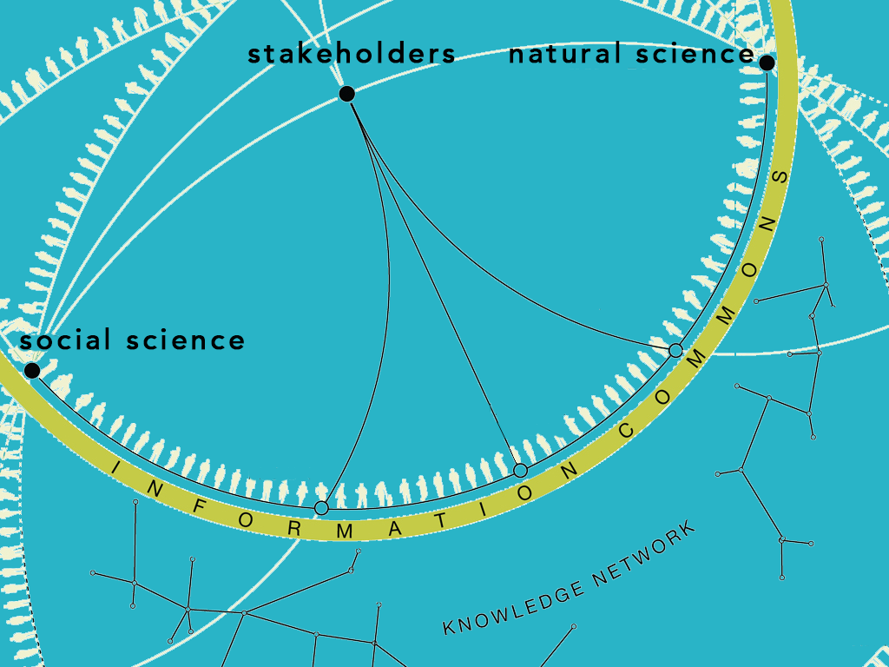

Slide 12
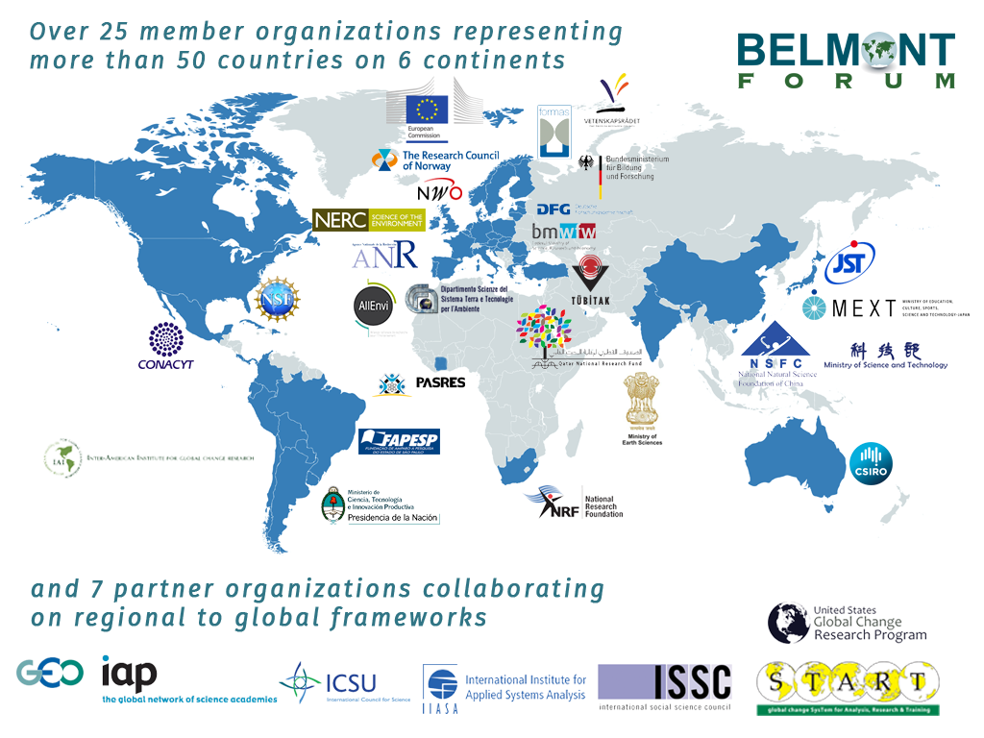

Slide 13
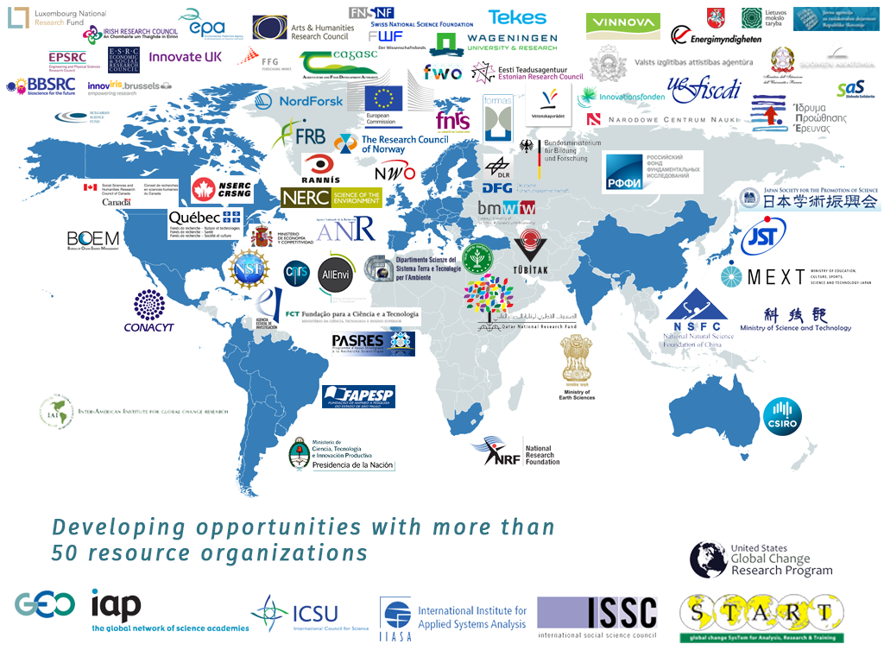

Slide 14
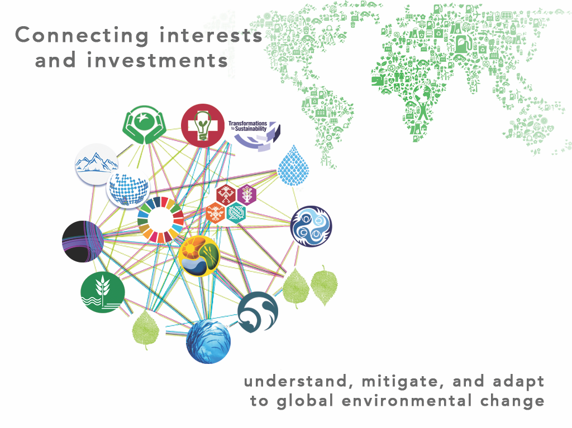
Belmont Challenge

Slide 15


Slide 16


Belmont Forum
e-Infrastructure and Data Management
Collaborative Research Action

Slide 17
Community Strategy and Implementation Plan
Unified vision
Global e-infrastructure
Research policies
Prioritize actions for interoperability
Needs
Barriers
Gaps
Inform stakeholders
Integrate existing efforts for a holistic environmental support system

Slide 18
Recommendations
Adopt Data Principles
Promote effective data planning and stewardship
Determine international and community best practice
Support cross-disciplinary training
Foster communication, collaboration and coordination

Slide 19
Widen access to data
Coordinate and integrate
Fill critical gaps
Share best practices
Foster new data literacy
Long-term preservation
Improve data management
Data Policy & Principles
2015 Belmont Forum Principals Meeting Oslo, Norway

Slide 20
Data
Understandable all users
Manageable and protected
Discoverable
Open by default
Available minimum delay
Sustainable, trustworthy repositories
The Belmont Forum and its members will support and promote this data policy and principles with the intent of making these data principles enforceable over time.

Slide 21
Action Themes
e-Infrastructure
Human Dimensions
Data Planning
Coordination

Slide 22
Actions
Development Efforts
Track efforts of data-oriented organizations
Identify overlapping efforts and encourage synergy
Data Principles and Policies
Data Management Plans
Training / Education Courses

Slide 23
Opportunities moving forward
Show a coordinated front
Infrastructure sharing plan
Strategic Coordination Network
Working Groups
Community recognize the need – common goal
Science Users - end user needs
Security
Data Policy
Development of solutions for specific challenges
Develop ways to coordinate on-going efforts
Decadal surveys / Research priorities
Opportunities for research collaboration / leverage of existing infrastructure
What can be done with strategic partnerships?
Where do we need specific support?

